Slide 1
Food Grade Warehouse Monitoring system
By Group: A03
Janhavi Adhau (Roll No.:311002) (G.R. No.: 22010552) Vaibhav Adsare (Roll No.:311003) (G.R. No.: 22010758) Adinath Jadhav (Roll No.:311022) (G.R. No.: 22010969) Deep Jadhav (Roll No.:311023) (G.R. No.: 22010818)
S.Y. B.Tech. - SEM IV (Pattern 2020) - AY 2021-22
Internet of Things
Instructor
Dr. Pravin G. Gawande
Electronics and Telecommunication Department Vishwakarma Institute of Information Technology, Pune-48
Internet of Things

Slide 2
Outline
Selection of PBL and objectives Block diagram and working
Selection of microcontroller and other components Circuit diagram using EDA tool
Algorithm
Simulation using EDA tool and Results Hardware implementation
Working
Overall Conclusion References
1
2
3
4
5
6
7
8
9
10
Internet of Things

Slide 3
Selection of PBL and objectives
Food Warehousing needs to be regulated at all times to keep products in safe conditions for consumption.
If the environment factors in a warehouse become too extreme, food and beverages can be compromised which can lead to making consumers very sick.
Environment monitoring allows warehouses to stay aware of the conditions of environmental factors.
Environment monitoring with Room Alert takes the safety and urgency of food warehousing a step further by allowing users to receive immediate notifications when changes in the environment occur.
It is crucial for certain foods and drinks to stay at specific temperatures, especially perishable foods as the growth rate of potentially harmful bacteria slows down drastically below specific temperatures.
Internet of Things

Slide 4
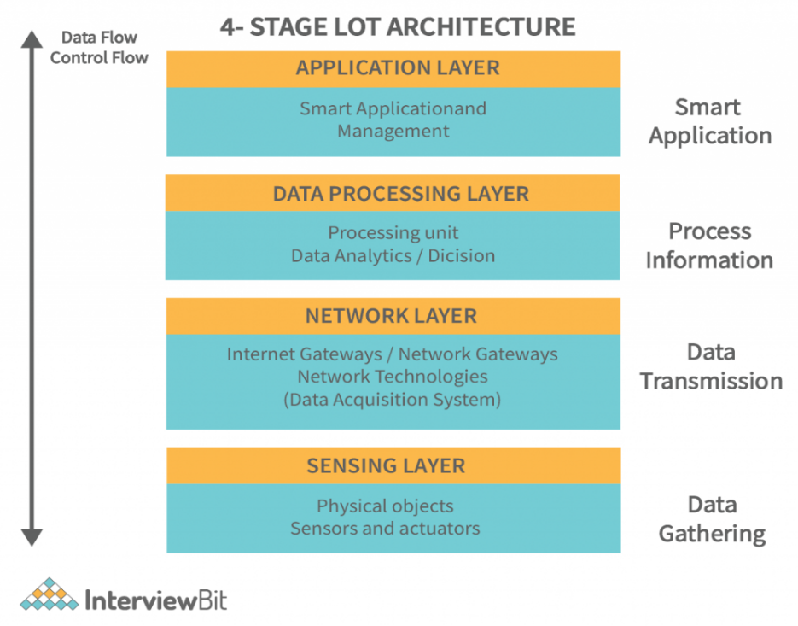
Use of IOT Layers

Slide 5
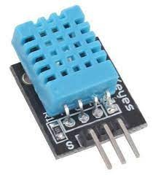
Use of Sensor in device
DHT11 sensor consists of a capacitive sensing element and a thermistor.
The humidity sensing capacitor has two electrodes with a moisture holding substrate as a dielectric between them.
For measuring temperature this sensor uses a Negative Temperature coefficient thermistor, which causes a decrease in its resistance value with increase in temperature. To get larger resistance value even for the smallest change in temperature.
Temperature range from 0 to 50 degree Celsius with a 2-degree accuracy.
Humidity range from 20 to 80% with 5% accuracy.
operating voltage from 3 to 5 volts.
The maximum current used while measuring is 2.5mA.

Slide 6
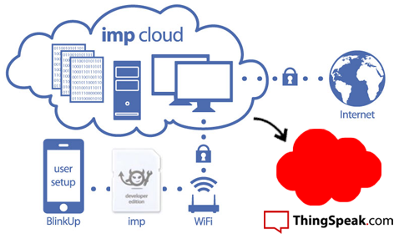
Use of ThingSpeak cloud platform
Use of ThingSpeak cloud platform
Cloud computing enables companies to store, manage and process data over cloud-enabled platforms providing flexibility, scalability and connectivity.
ThingSpeak allows us to aggregate, visualize and analyze live data streams in the cloud.
Prototype and build IoT systems without setting up servers or developing web software.
Some of the key features of cloud platform are:
Easily configure
Visualization
Data Aggregation

Slide 7
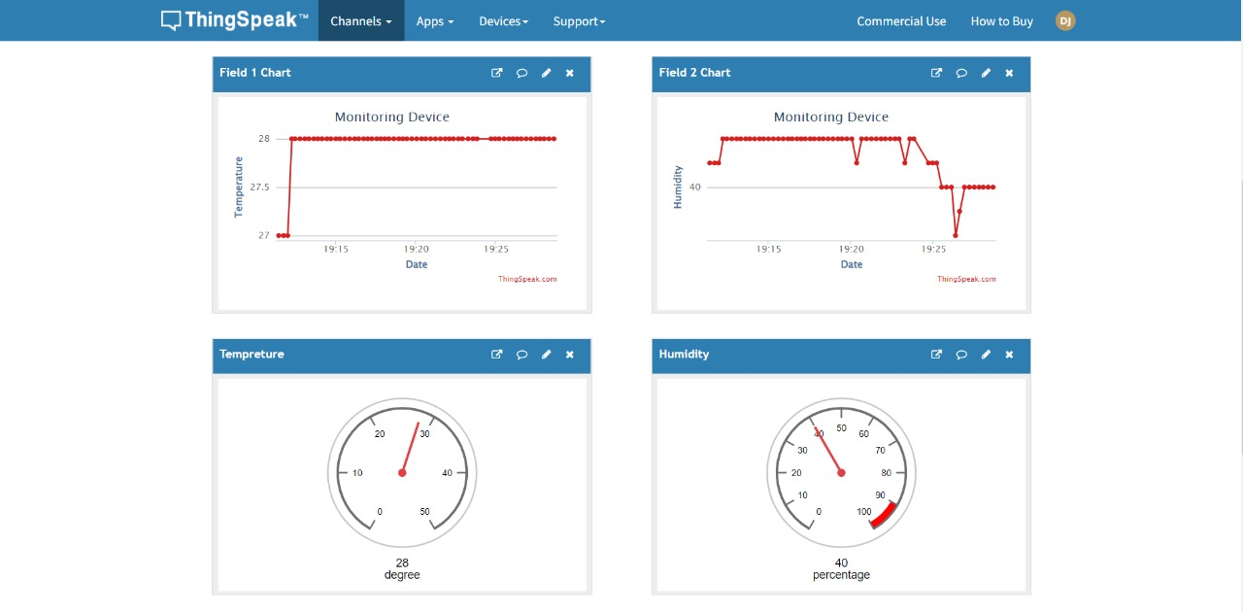
Use of ThingSpeak cloud platform

Slide 8
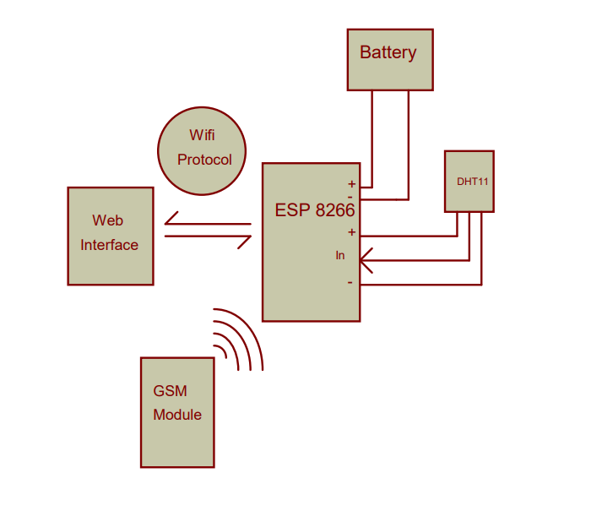
Block Diagram and working
Internet of Things

Slide 9
Selection of IOT devices
ESP8266:-
Enables microcontrollers to connect 2.4 GHz Wi-fi
provide Wi-Fi connectivity to external host MCUs
RISK type architecture with 3.3 V operating voltage
DHT11:-
calibrated digital signal output.
high reliability and excellent long-term stability
connects to a high performance 8-bit microcontroller
fast response, anti-interference ability and cost-effectiveness.
Internet of Things

Slide 10
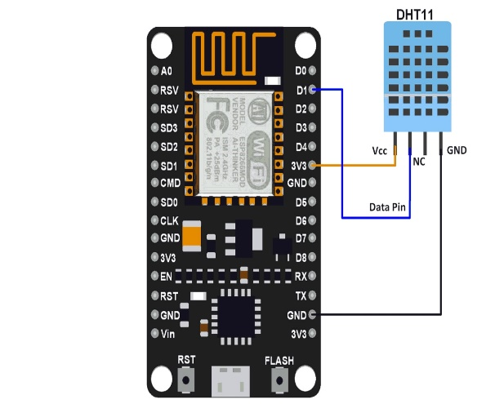
Circuit diagram using EDA tool
Interface DHT11 Using NodeMCU
Internet of Things

Slide 11
Algorithm/Flowchart
Temperature
Humidity
Dht11
ESP 8266
Warehouse
Remote Access
ThingSpeak Cloud
User Interface
Internet of Things

Slide 12
Working
Temperature and Humidity sensation by DHT11 sensor.
Data acquisition by using ESP8266 Node MCU.
By using 802.11(Wi-Fi) data will be stored on the cloud .
By using user interface of ThingSpeak cloud computing website data is rearranged with the Data and information visualization.
By using the statical data provided by the cloud computing website it is easy to analyse the environmental changes of food category warehouse.
Internet of Things

Slide 13
Overall conclusion
It’s a cost-effective and dependable way to track temperature and humidity inside warehouses without compromising stored items. The devices are simple to set up and save electricity.
We have successfully utilized 4 layers (sensing layer ,Network Layer, Data processing layer and application layer).
Ensures us to stay aware of the conditions of environmental factors.
It is crucial for certain foods and drinks to stay at specific temperatures, especially perishable foods as the growth rate of potentially harmful bacteria slows down drastically below specific temperatures.
Internet of Things

Slide 14
References
Bartholdi, John J; Hackman, Steven Todd (2006). Warehouse distribution science. Atlanta, GA: The Supply Chain and Logistics Institute, School of Industrial and Systems Engineering, Georgia Institute of Technology. p. 34. OCLC 938330477. Faber, Nynke; de Koster, Ren´e (Marinus) B.M.; van de Velde, Steef L. (2002-01-01). ”Linking warehouse complexity to warehouse planning and control structure: An exploratory study of the use of warehouse management information systems”. International Journal of Physical Distribution Logistics Management. 32 (5): 381–382. doi:10.1108/09600030210434161. ISSN 0960-0035. Facilities
planning. James A. Tompkins (4th ed.). Hoboken, NJ: John Wiley Sons. 2010. pp. 385–386. ISBN 978-0-470-44404-7. OCLC
456838083. ”Warehouse Management Systems Market Report, 2021-2028”. www.grandviewresearch.com. Retrieved 2022-03-23. Frazelle, Edward (2016). World-class warehousing and material handling (2nd ed.). New York. p. 14. ISBN 978-0-07-184283-9.
O_{S.Y}C_{. B}L_{.T}C_{ech}9_{. -}5_{S}1_{EM}42_{IV}9_{A}3_{Y} 2₂₀5₂₁.₋₂₂Ghiani, Gia_{In}n_{te}p_{rn}a_{et}o_{o}l_{f}o_{Thi}(_{ng}2_{s}004). Introduction to logisti₁c_{2 /}s₁₂

